Slide 1
Introduction to SQL: Structured Query Language
By AppJedi
September 6, 2026
Stored Procedures

Slide 2
Stored Procedures
A stored procedure is a set of pre-written Structured Query Language (SQL) statements saved within a database management system that can be executed as a single unit, allowing for reusable code to perform complex operations on data within the database, often with the ability to accept input parameters to customize the operation based on the data provided

Slide 3
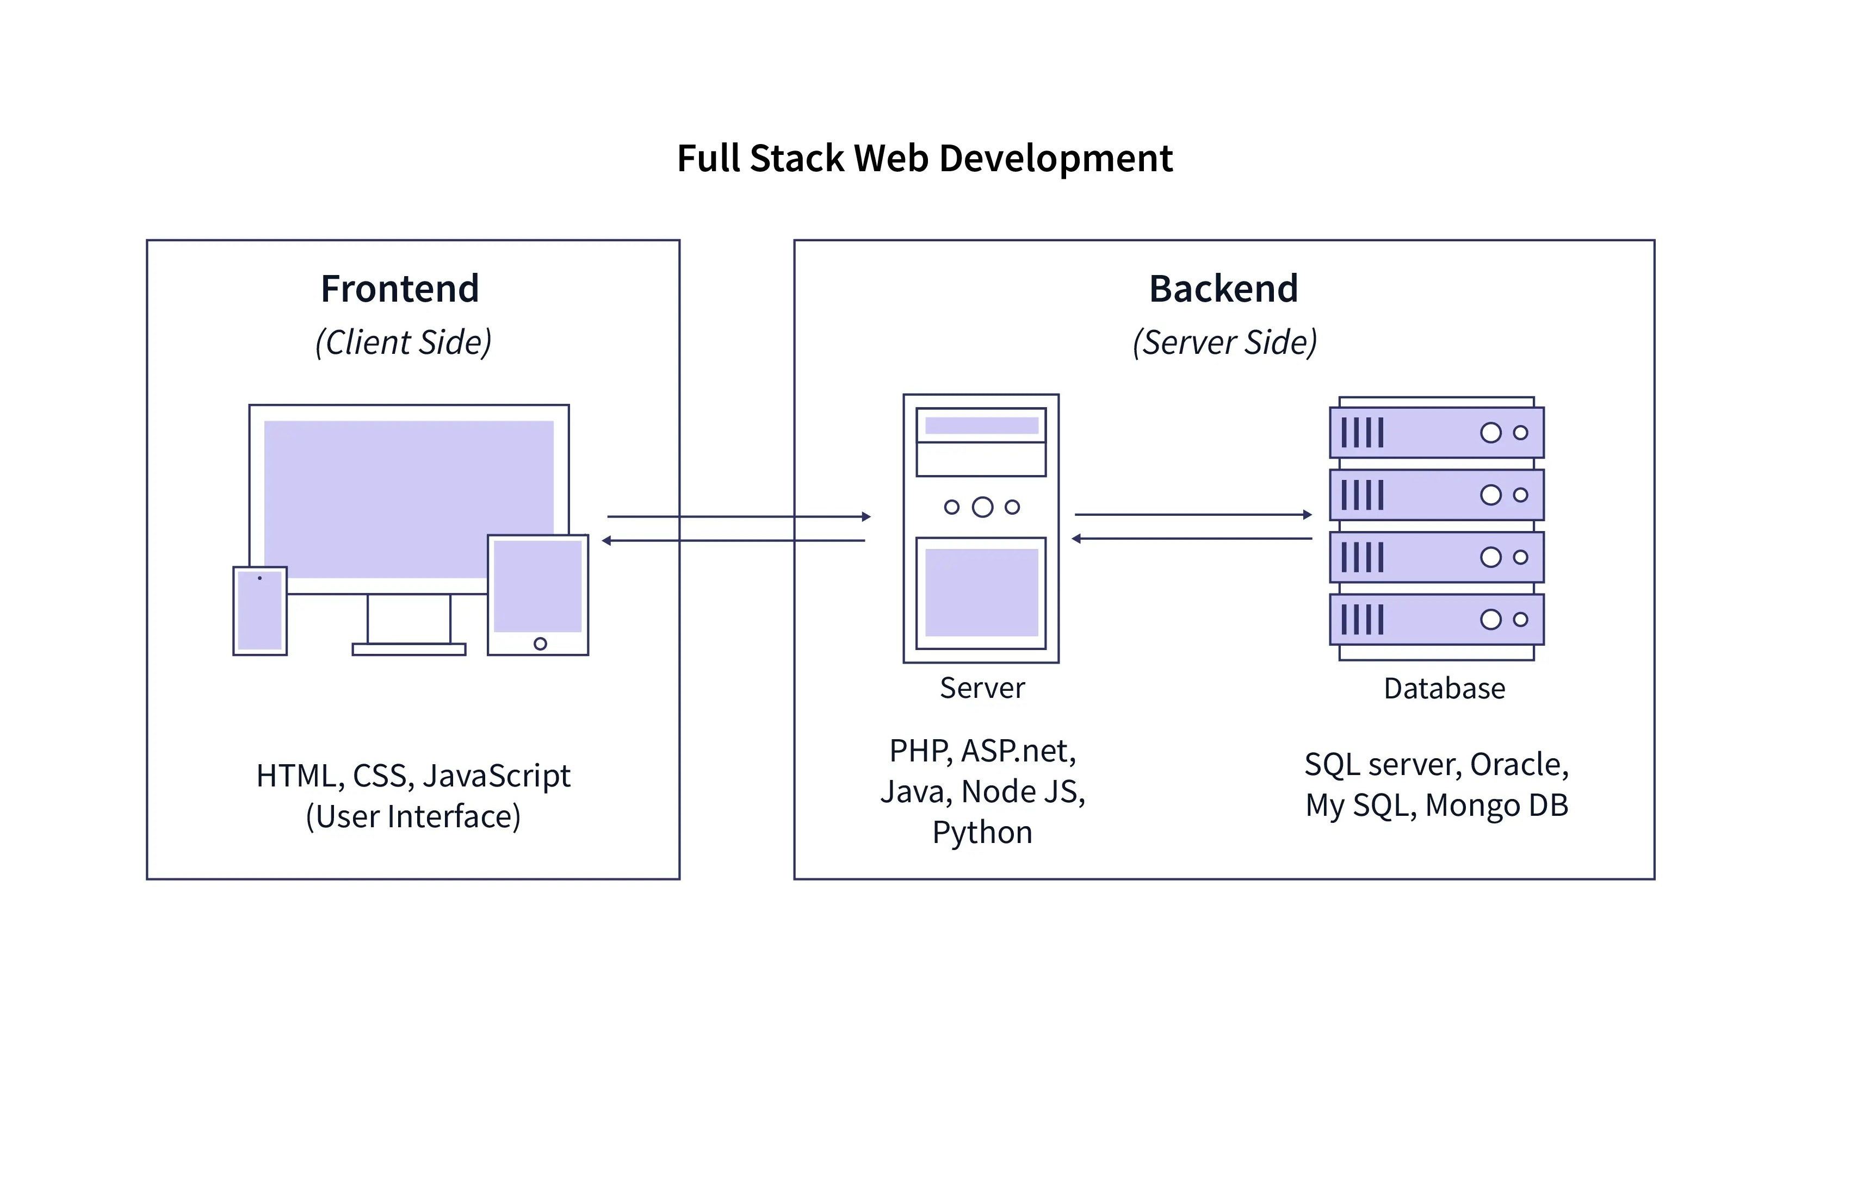
Client/Server Architecture:

Slide 4
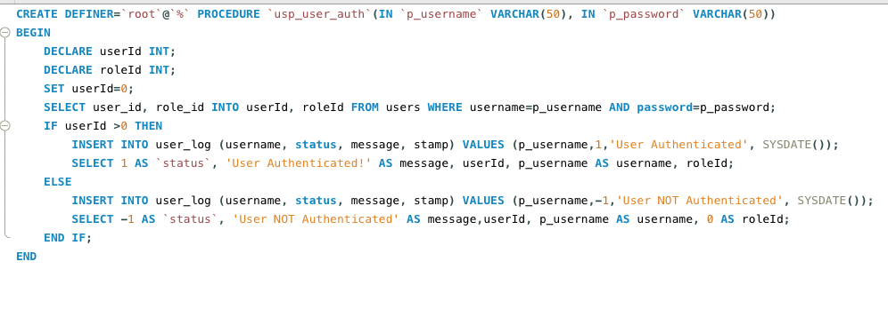
Stored Procedure

Slide 5
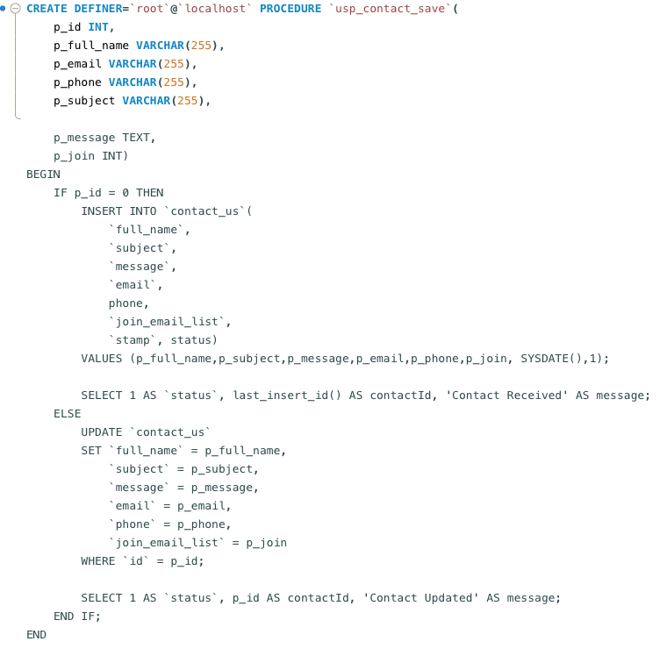
Stored Procedure:

Slide 6
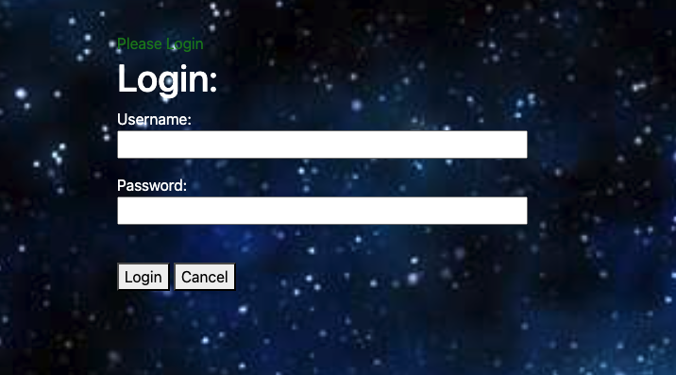
Login from web client

Slide 7
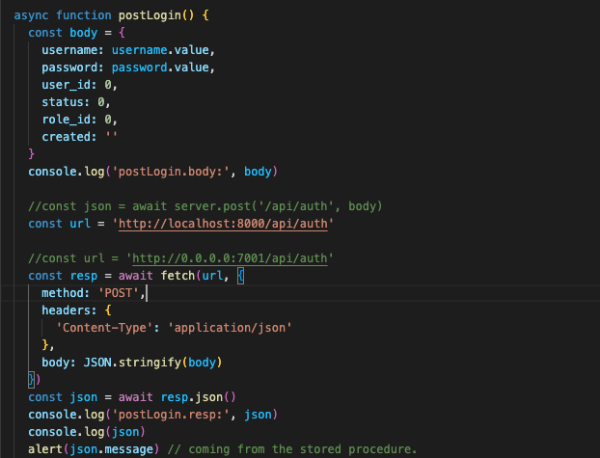
Web Client code to send username/password to server

Slide 8
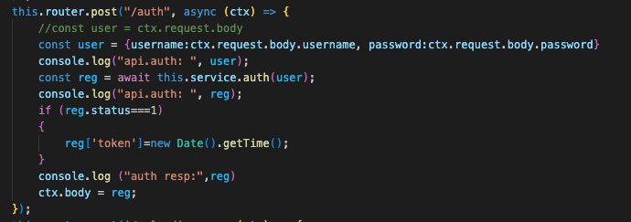
/api/auth

Slide 9
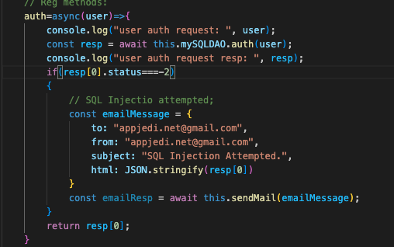
Service layer:

Slide 10
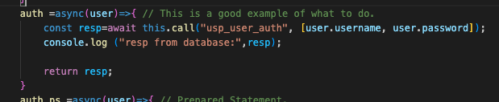
DAO Auth call to stored procedure

Slide 11
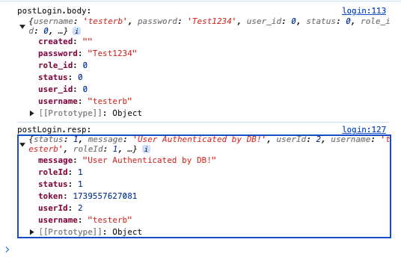
Client console.log

Slide 12
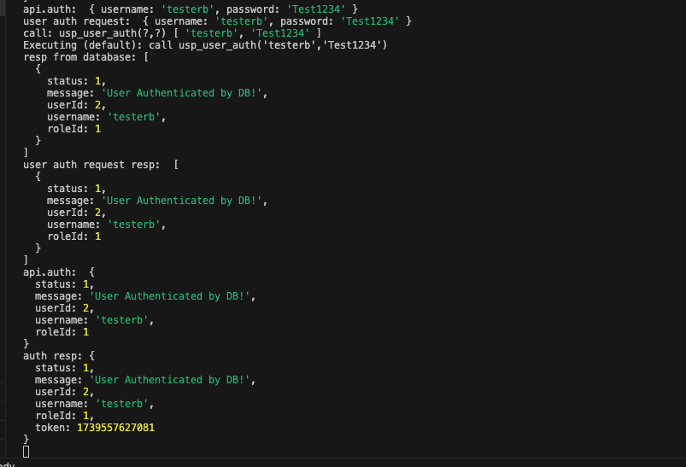
Server console.log

Slide 13
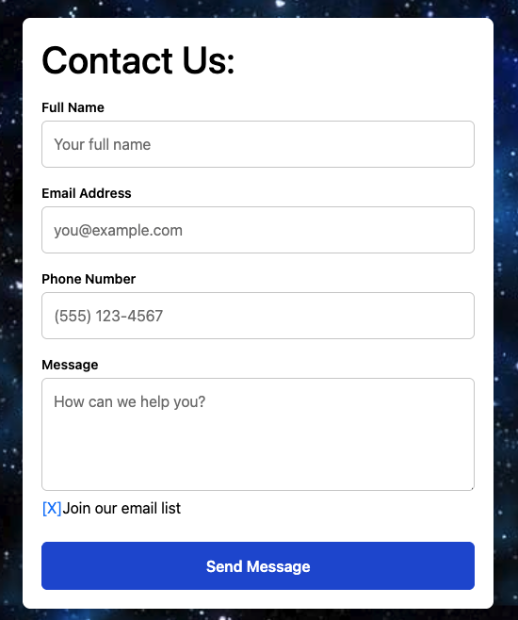
Enter date from web client:

Slide 14
Data Validation
Data validation is the process of checking and ensuring the accuracy, quality, and consistency of data by verifying that it meets specific criteria, such as correct data types, format, range, and logical consistency, before using it in analysis or processing

Slide 15
Where is it done?
Client browser, smart phone, etc. (really bad idea)
App Server. (ok but not the best)
Database server. (best choice. Self-defending database)

Slide 16
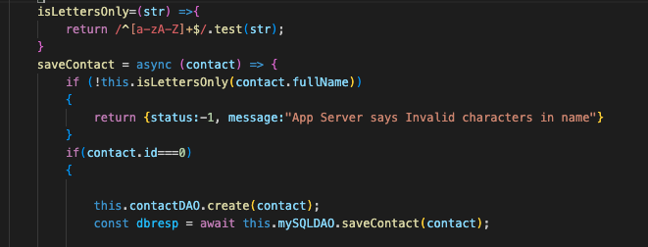
App Server:

Slide 17
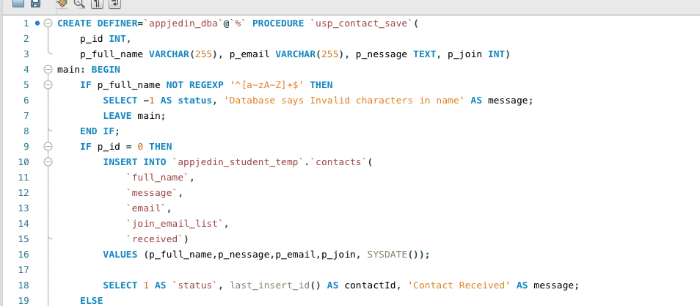
Database Stored Procedure

Slide 18
Why Database instead of App Server?
The database should defend itself. Although both the App Server and Database server are behind the firewall and controlled by the same organization the database is still depending on an external service to defend its data. By putting validation in the stored procedure the database is defending its own data.

Slide 19
NEXT
Questions?
www.appjedi.net

